Slide 1
Terraform

Slide 2
What is terraform ?
Terraform is an open source tool created by HashiCorp and written in the Go programming language, this tool allow you to define your infrastucture as a code, using a simple and declarative programming language called HCL (HashiCorp configuration language).
Terraform can manage and build (immutable)infrastructure across a variety of public cloud providers. Currently it have more than 40 providers this impressive list includes not only the majors cloud providers such as AWS, Google Cloud, Microsoft Azure, it also contain the small ones like Fastly(CDN), Heroku, CloudStack, etc. using a few commands.
This tool allow you to create servers, databases, caches, load balancers, queues, monitoring, subnet configurations, firewalls, routing rules, etc.

Slide 3
Terraform is an open source utility, created by a HashiCorp company, the same company that created
Vagrant, Packer, Consul, and other popular infrastructure tools. It was initially released in July 2014
and since then has come a long way to become one of the most important tools for infrastructure
provisioning and management.
From physical servers to containers to SaaS products, Terraform is able to create and
compose all the components necessary to run any service or application. With Terraform, you
describe your complete infrastructure as code, even as it spans multiple service providers.
Your servers may come from AWS, your DNS may come from CloudFlare, and your database
may come from Heroku. Terraform will build all these resources across all these providers in
parallel. Terraform codifies knowledge about your infrastructure unlike any other tool before,
and provides the workflow and tooling for safely changing and updating infrastructure.
As a part of its Atlas product, HashiCorp also offers a hosted service named Terraform Enterprise,
which solves some of the problems that open source version doesn't handle well

Slide 4
Terraform vs Other infrastructure code tools
Terraform, CloudFormation, OpenStack vs Chef, Puppet, Ansible, SaltStack.
Provisioning versus Configuration management.
Immutable infrastructure vs mutable infrastructure.
Declarative language versus Procedural language.
Masterless versus Master.
Agentless versus Agent.
Small community versus Large community.
Cutting edge versus Mature. (see page 38 -> 205 Terraform up and running)

Slide 5
Mutable vs Inmutable (infrastructure)
Configuration management tools (Chef, Puppet, Ansible, etc), use the mutable infrastructure paradigm. For example if you use Chef to install a new versión of an app, it will run the software update on your existing servers and the changes will happen in place. Over time as you apply more and more updates each server builds a unique history of changes. As a result, each server becomes slightly different then the others leading to configuration drift problems.
On the other side if you use terraform to deploy machines you could use docker to create a new image with the new app versión in a new image, deploy the image on new servers and then undeploy the old servers. Since every deployment uses immutable images on fresh servers, this approach reduces the configuration drift bugs.

Slide 6
Amazon Web Services (AWS)
AWS is the most popular cloud infrastructure provider by far. It has a 45% share in the cloud infrastructure market, which is more tan the next three biggest competitors (Microsoft, Google and IBM) combined.
AWS provides a huge range of reliable and scalable cloud hosting services.
AWS offer a Free Tier for new accounts with certain limitations during one year. For example we can use a single EC2 instance for 750 Hours a month for 12 months for free, as long as it have the t2.micro type.

Slide 7
We will use the t2.micro instance type, as it's the cheapest
one and is available as part of Free Tier offering.

Slide 8
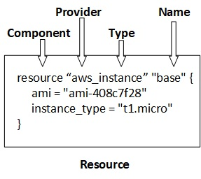
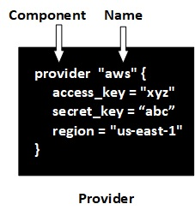
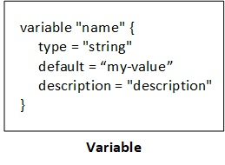
Elements that a terraform script contains.
Provider -> This connect Terraform to the infrastructure you want to manage.
Resource -> They represent the infrastructure components you want to manage : hosts, networks, firewalls, databases, etc.
Tags -> Almost any resource could have one or several tags.
Meta-Parameters -> A parameter that exists on every resource in terraform.
Variables -> They have a name, an optional type, a default value and a description.
Strings
Maps
Lists (array)

Slide 9
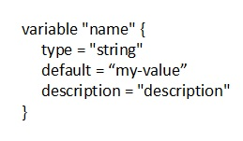
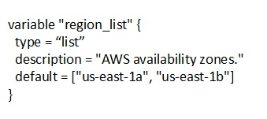
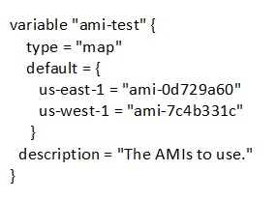
Variables
Strings List (array)
Maps
A variable in the form: variable “my-param” {} -> it means that their required value are hidden for example as environment variables (TF_VAR_ami-test), or is going to recover their value from the console (inline value) or other hidden ways (like when a configuration file sends a parameter to the module).

Slide 10
Terraform basic commands
terraform init -> Used to initialize and download the required provider.
terraform get-> Used to get the required modules on the configuration files.
terraform validate -> Used to validate and check the source code syntax.
terraform fmt -> Used to format the source code of the configuration files.
plan -> Show us the changes that terraform will make to our infrastructure.
apply -> Apply the changes to our infrastructure (builds or update it).
show -> Show us the status of the infrastructure.
state list -> Display the state of the infrastructure in a human-readable format.
graph -> Show the terraform infrastructure as a graph.
destroy -> Command used to delete the infrastructure built with terraform.

Slide 11
Modules
terraform get, this command needs to be executed the first time that a module is going to be loaded, and also everytime that are backend changes in the configuration file like adding or updating the state file to an AWS S3 bucket.
Even though we specified source, Terraform still can't find our module. It requires you to run the terraform get command first. When you run this command, Terraform downloads the module to the .terraform folder inside your project's folder. If your module is local to your laptop, Terraform will simply create a symlink from it to the .terraform folder.
There are other types of sources for modules. You could specify a Git repository, HTTP URL, GitHub, and BitBucket links as a module source. In large organizations, there are probably many different Terraform modules, and it's convenient to store them outside of project-specific repository.
Every time you run get command, it will pull it from the source and save it inside the .terraform folder.

Slide 12
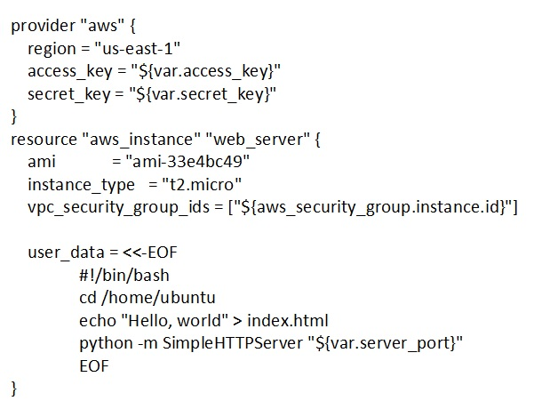
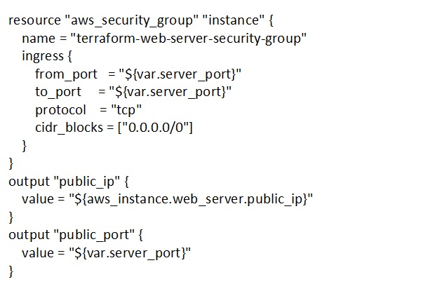
How to create and deploy an instance.
To deploy it, you just use a couple of commands: terraform init the first time and then only terraform apply -auto-approve and finally to destroy it terraform destroy.
You may have to retry the HTTP request several times, because the EC2 Instance may take a minute or two to start up.

Slide 13
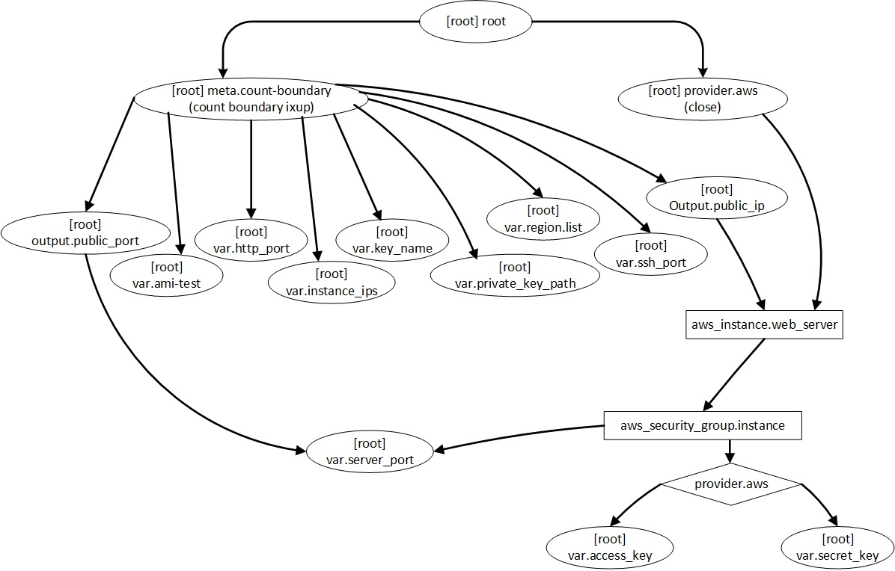
Graph of the basic instance example.
http://www.webgraphviz.com/

Slide 14
Previously, we have managed only one resource with Terraform-a single EC2 instance. Obviously, the real infrastructure is much more complicated than a single server. The more resources you have, the more dependencies between them you have to handle. Also, when the number of resources grows, you will have hard time managing them via single huge template file.
Here we will learn one of the most important terraform feature: dependency graph, then when our template is too big, we will use terraform modules with the DRY principle.

Slide 15
If your execution plan had failed, then terraform would not rollback the resources. Instead it will mark the failed resource as tainted. The tainted state of terraform is a way to say “This resource may not be right”. Terraform always holds the execution plan: it was asked to create a resource, not delete one. If you run the execution again, terraform will attempt to destroy and recreate any tainted resources.
It's a good practice to always run plan before apply. This saves you from accidental deletion or resource updates that you didn't plan to have.

Slide 16
Virtual private cloud (VPC)
VPC is a virtual network that you can divide it into subnets. Some subnet can be public(with access to the internet) and some are private. You can define routing between subnets, and by default, they can freely access each other. You can also create VPN to your VPC, add NAT gateways, manage DHCP options, etc.
Security groups are also a part of AWS VPC. With security groups you can define inbound and outbound firewall rules and then you can attach these groups to EC2 instances.
Some companies take this process to extreme levels by baking tons of AMIs every day and recreating existing instances with new AMIs, instead of performing in-place upgrades. This approach enables to achieve so-called immutable infrastructure, where you never touch a running server at all and each update is performed by recreating an instance. We will learn how to do immutable infrastructure with Terraform in Chapter 6, Scaling and Updating Infrastructure.

Slide 17
In this chapter, you will learn how to connect Terraform with other tools, most importantly with configuration management systems: how to make it play well with Ansible, Chef, and Puppet, how to bootstrap your machines properly, and how to invoke basically any other tool that you need to support your infrastructure. You will learn some new tools, such as testing frameworks and wrappers around Terraform state files. We will also take a sneak peek into a plugin system of Terraform.
One problem with count is that it cannot be used with modules.

Slide 18
Don't get me wrong: configuration management is still a must. But context changed a bit after virtualization got a huge adoption in the form of Cloud providers. The time required to create a server was cut down to few minutes, instead of hours and days. More importantly, time required to recreate a server is also really low, compared with the bare metal world. So why bother with keeping the existing machine updated, if you could just destroy it and create new one from scratch? That's the basis of a so-called Immutable Infrastructure.
Netflix is perhaps the brightest example of adoption of this approach. As they are one of the biggest AWS EC2 users, they run all of their workloads in the Cloud on virtual servers. Their processes are well covered in multiple blog posts in the Netflix technology blog, for example AMI Creation with Aminator (http://techblog.netflix.com/2013/03/ami-creation-with-aminator.html).

